Slide 1
Analysis of mask mandates and their impact on restaurant usage by state
Steven Broyles

Slide 2

Data Preparation
Mandate Data from CSVs on mask mandates across all US counties
Parsed data down to represent state level
Merged with CSV on restaurant reservations for comparative analysis
Sources: https://catalog.data.gov/dataset/u-s-state-and-territorial-public-mask-mandahttps://www.opentable.com/state-of-industrytes-from-april-10-2020-through-january-10-2021--e0ce3
https://www.opentable.com/state-of-industry

Slide 3
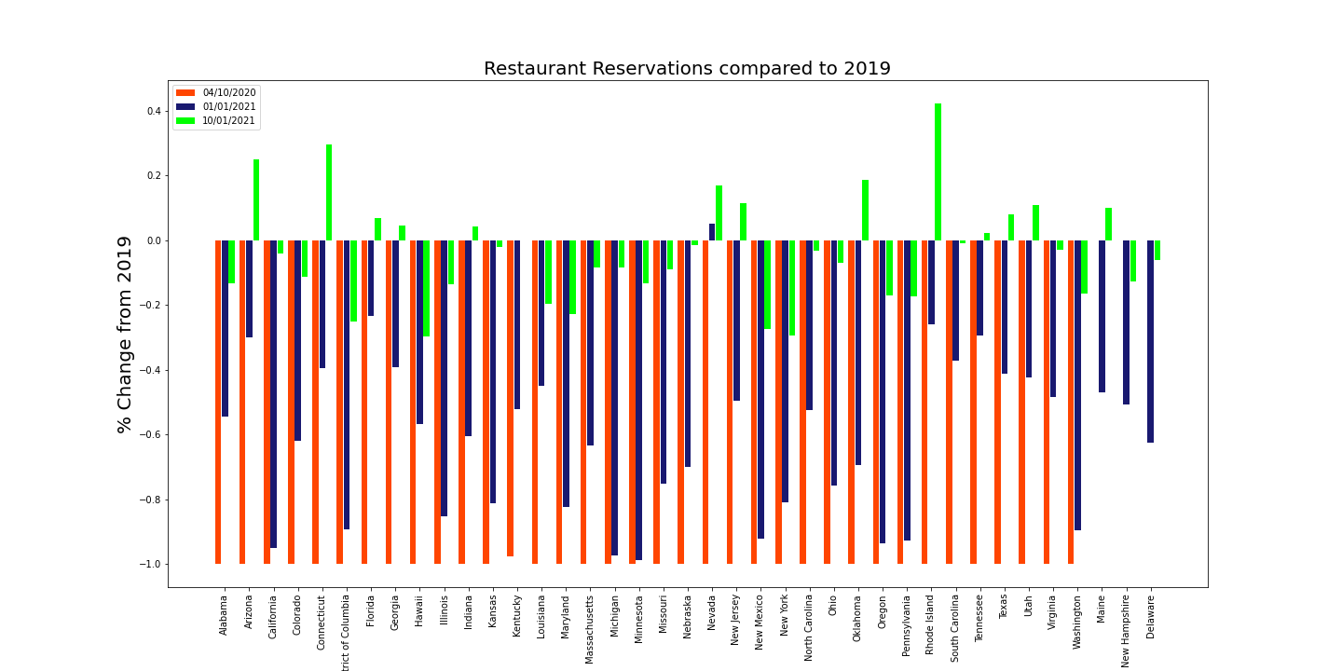
Analysis
The bar chart represents an increase in restaurant utilization as time progressed
States that were excluded because of lack of restaurant data: Alaska, Arkansas, Idaho, Iowa, Montana, Mississippi, North Dakota, South Dakota, Vermont, West Virginia, Wisconsin, Wyoming

Slide 4
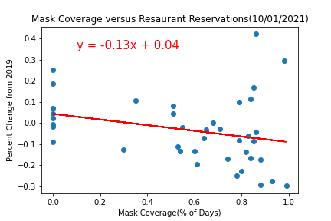
Further Analysis and Conclusions
P-value: 0.08873673599757953
R-value: -0.27620983180473435
Though a negative trend is observable, a p-value of < 0.05 suggests the correlation is not statistically significant

